Slide 1

Project On
Countries of the World
Web Scraping & Exploratory Data Analysis

Slide 2
About me
My Name is Chelikani Harshini
I completed my Bachelor of Technology in Computer Science and Engineering from Cmr Institute of Technology in 2023

Slide 3
Introduction
Web scraping is the process of extracting useful data from messy web pages.
It helps collect structured information (like tables, lists, or text) from unstructured HTML pages.
libraries such as: Requests, BeautifulSoup as bs4, Pandas

Slide 4
Data Source for scrapping data
Website Used: https://www.scrapethissite.com/pages/simple/
Contains Country Details: Country Name
Capital Population Area

Slide 5
Workflow
Import libraries(Requests, BeautifulSoup as bs4,Pandas)
Send requests to the website using(requests.get())
converts the raw HTML into a structured format (BeautifulSoup) default parser as html.parser
Locate Elements(tags, classes)
Extract required fields like: (name, capital, population, area)
Store data in a Structured format by using pandas DataFrame
Export to CSV file for analysis

Slide 6
Functions Used
soup.find() - returns first match
soup.find_all() - returns all matches
.text - extract text content
.find() locates a specific tag inside each <div>.
.get_text(strip=True) extracts only the text (removes HTML and extra spaces

Slide 7
Data Preprocessing
Loaded the scraped data into a Pandas DataFrame
Checked dataset shape and structure (df.shape, df.head(), df.info(), df.describe())
Analyzed categorical data with .value_counts()
Handled missing values (df.isnull().sum())

Slide 8
Feature Engineering
After scraping, we enriched the dataset by adding three new columns: 1. Population Density = Population/Area
Population Category
Small → Population < 1M
Medium → 1M – 50M
Large → > 50M
Area Category
Tiny → Area < 10,000 sq.km
Medium → 10,000 – 500,000 sq.km
Large → > 500,000 sq.km

Slide 9
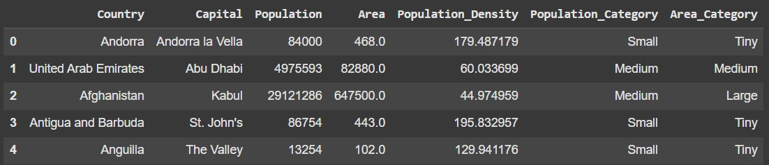
Sample Data
Dataset Overview
Total Rows
•
: 600
Total Columns : 7

Slide 10
Handling Missing Values and Outliers
Found missing values in 4 columns(Capital, Population_Density, Population_Category, Area_Category)
Handling Missing Values:
Numerical columns → filled with Mean
Categorical columns → filled with Mode
Outliers are detected by using boxplot, Population column consist of outliers. It can be removed by using
IQR = Q3 – Q1
Lower Bound= Q1 - 1.5 * IQR
Upper Bound = Q3 + 1.5 * IQR

Slide 11
Bivariate Analysis
It shows relationship between two variables
GroupBy → Categorical vs Numerical
Ex: examined relationship between Country and Population by aggregation mean
Crosstab → Categorical vs Categorical
Ex: examined relationship between Population_Category and Area_Category columns
Correlation → Numerical vs Numerical
Ex: examined relationship between Population and Area

Slide 12
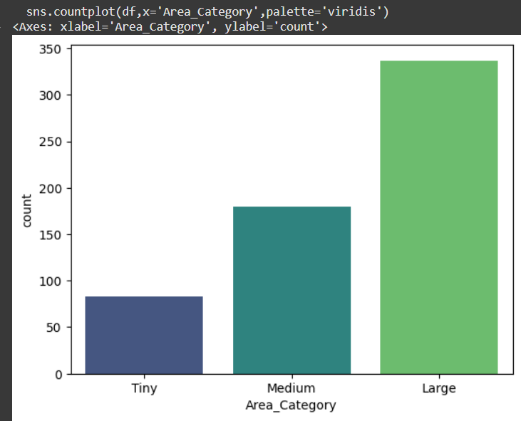
Number of Countries by Area Category
Countplot : To visualize how many countries fall into each Area_Category (Small, Medium, Large).
Most Countries are classified as small Area
Fewer Countries fall under large area.

Slide 13
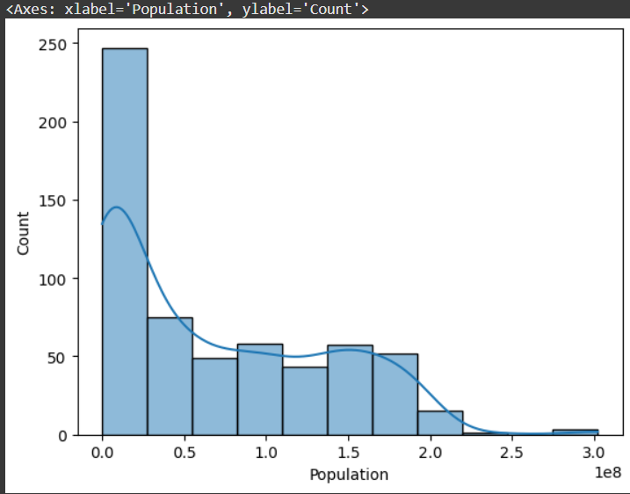
Population by Area
Histogram + KDE : shows the frequency distribution of country populations.
KDE (Kernel Density Estimate) provides a smooth curve to better understand the shape of the distribution.
Majority of countries fall in the low to medium population range.
The KDE curve shows Right Skewness

Slide 14
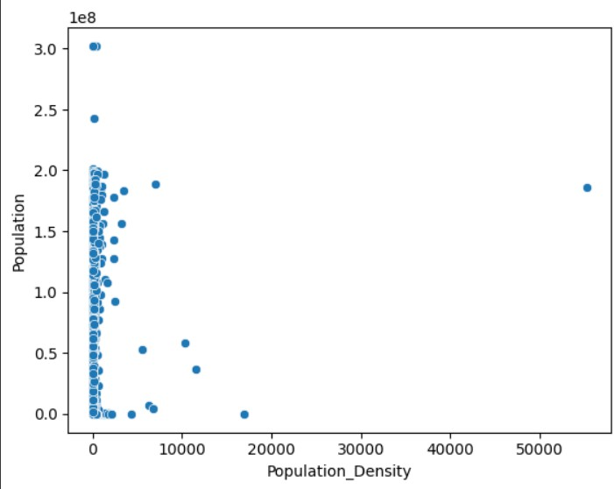
Population vs Population Density
ScatterPlot : To visualize the relationship between population and Population Density
Each dot represents a country
Most Countries are clustered at low density and low population
High Population doesn’t always
mean high density(large countries like India/China have huge population but extreme density due to land Area

Slide 15
Insights
Majority of the world consists of small-sized, low-population countries.
A handful of outliers dominate global statistics (very high population or area).
Countries with small area but moderate population → very high
density (urbanized nations).
Feature engineering (Density, Categories) helped highlight hidden patterns.
The dataset is imbalanced, so future models would need scaling or stratification.
Web Scraping + EDA pipeline successfully transformed raw HTML data into a clean, structured dataset

Slide 16
THANK YOU

